Slide 1
FogBus
A simplified framework for implementing Fog, Edge and Cloud computing applications/research secured using Blockchain Technology
Shreshth Tuli

Slide 2
FogBus : Introduction
FogBus is a lightweight and platform independent framework which allows an end-to-end implementation of fog, edge and cloud computing environment. It is designed to run on almost all IoT/embedded devices and support a wide range of machines in terms of their computation capabilities
The framework integrates all edge devices (using a lightweight balancing framework for small-scale computation) and also cloud/other heavy devices (using the Aneka framework for heavy computation) and provides an end to end solution for integrating computation at different levels to provide better latency (by allocating simple and small-scale work to edge nodes) and high computation power (by allocating heavy computation work to cloud), which in effect to the end user feels like high computation with low latency

Slide 3
Network Model
The overall model is based on Master-Slave design where the Master node receives data from sensor for analysis/computation. The Master node then sends this data as a task to different workers: Local worker, Private Cloud or Public Cloud. Therefore, the core components of network include Master Node, Worker Nodes, Sensors and Cloud. All other components including gateways, switches and other interface devices ‘glue’ the core components together

Slide 4
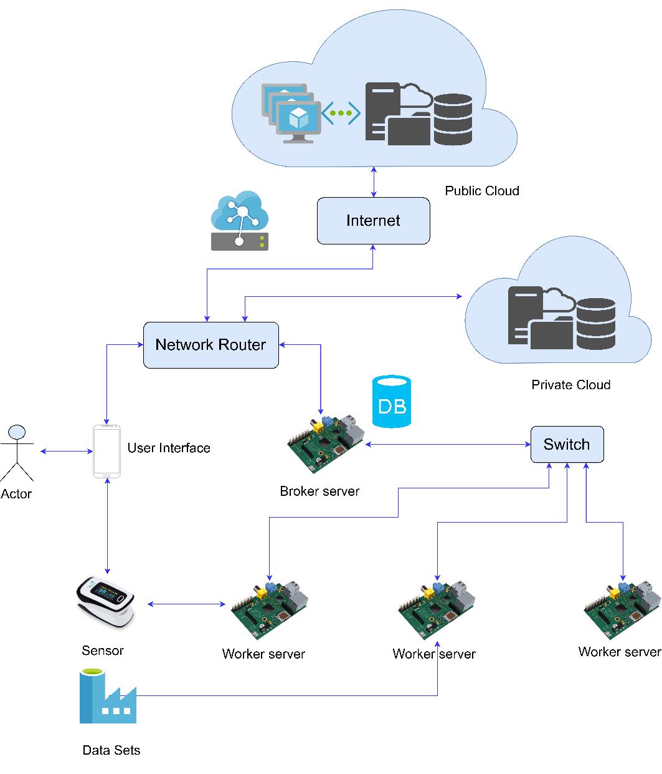

Slide 5
Master Node
The master node is the first point of contact for the end user. It has the following roles:
1. Take user login information and check with the Database
2. Maintain Database of registered users
3. Maintain configurations including Worker nodes’ IP addresses
4. Take data for analysis
5. Maintain and validate blockchains
6. Distribute data with other parameters among worker nodes and Aneka (or itself)
The Worker Nodes and Aneka container perform analysis, validate proof-of-work and send back results to master

Slide 6
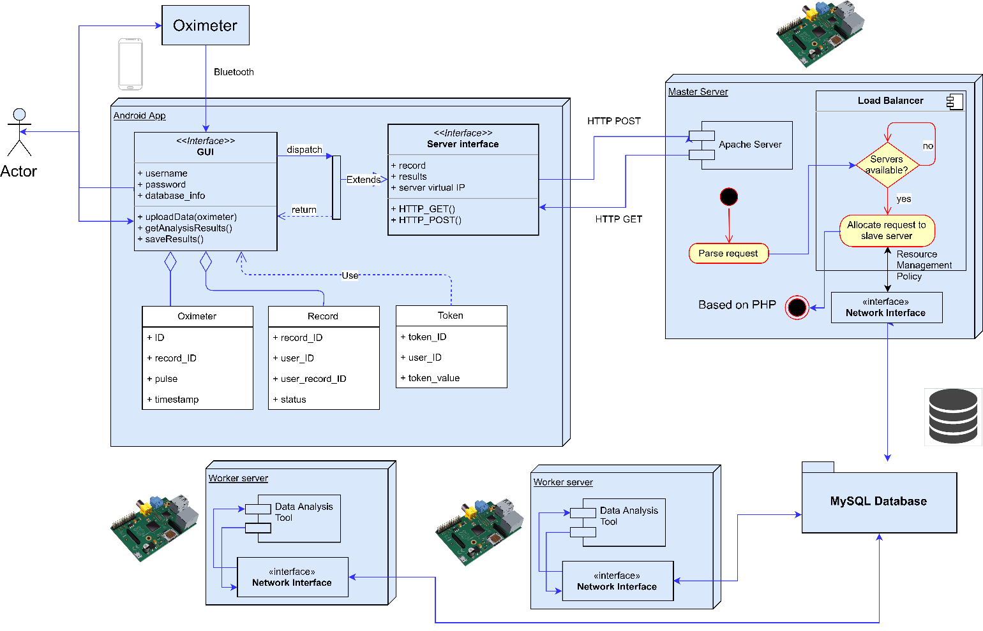
Current Setup: Sleep Apnea Analysis

Slide 7
Implementation
The software has been built using platforms that are supported by a wide range of devices including those used for IoT application. The main software is divided into four different components:
Interface Web Scripts (Based on PHP)
Blockchain Interface (Based on Java)
Aneka analysis code (Based on C# and .NET)
Analysis Jar file (Based on Java)
User Interface (Android App, or web-based interface)

Slide 9
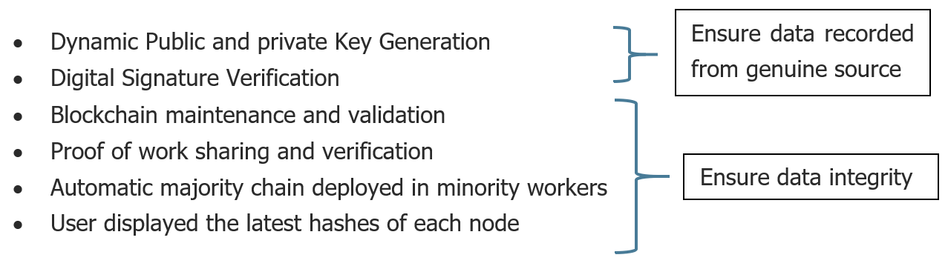
Blockchain

Slide 10
Blockchain – Master Node
MasterInterface.jar
This file acts as the blockchain interface for the Master node. It forms new blocks and generates random public/private key value pairs and shares with worker nodes. It also maintains its own blockchain and sends data, hash values and proof-of-work to other nodes for verification. All hashes are generated using SHA256 algorithm and data transferred in Base64 encoding.
Each block also maintains it’s timestamp of creation for backtracking and validation of chronological sequence of block creation in the chain. This helps in checking if a block created later in time has not been inserted in between in fraudulent manipulation.

Slide 11
Blockchain – Worker Node
Data validation includes the following checks:
Checking the source:
Public Key received matches the registered public key of master node
Signature Verification of data received with the public key
Checking the block:
Hash of the block matches the calculated hash value
Proof-of-work follows the required pattern
Previous hash corresponds to the hash of the latest block

Slide 12
Physical Infrastructure
Physical Infrastructure:
Master Node: Dell XPS 13
Worker Node: 2x Raspberry Pis
User Interface: Android Device
Sensor: Pulse Oximeter

Slide 13
Data Analyzer
Open Source Data analysis software
Gives results as:
AHI (Apnea Hypopnea Index) : Higher means more sever the disease
ECG (Electrocardiogram) Diagnosis
Graphs of Oxygen level and Heart Rate with time

Slide 14
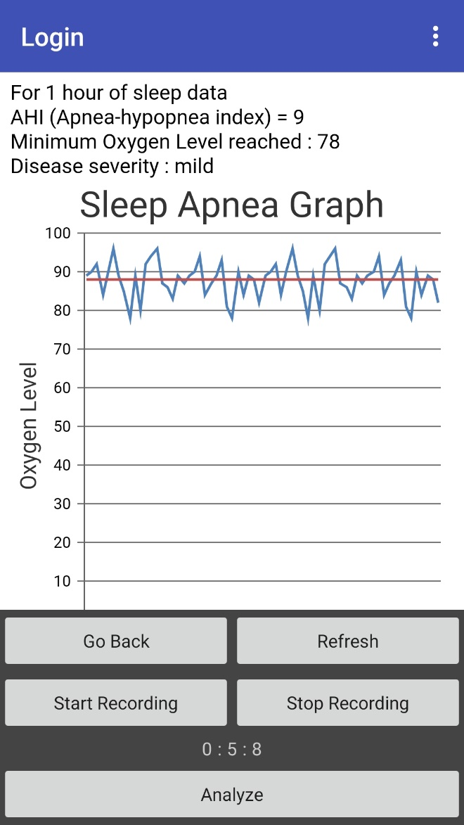
Android Interface

Slide 15
Applications of FogBus
Easy setup of Fog and Cloud environments
Low Cost solutions for:
Secured Health Monitoring
Smart Cities
Efficient Agriculture
And automating other daily life tasks

